Slide 1
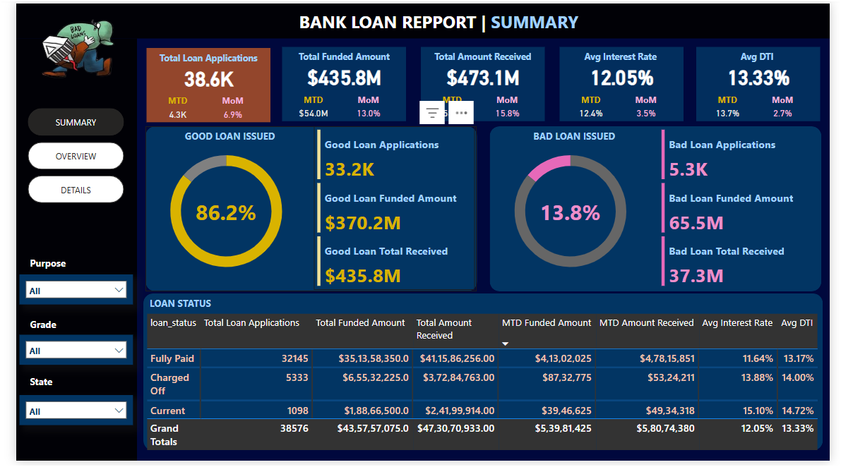
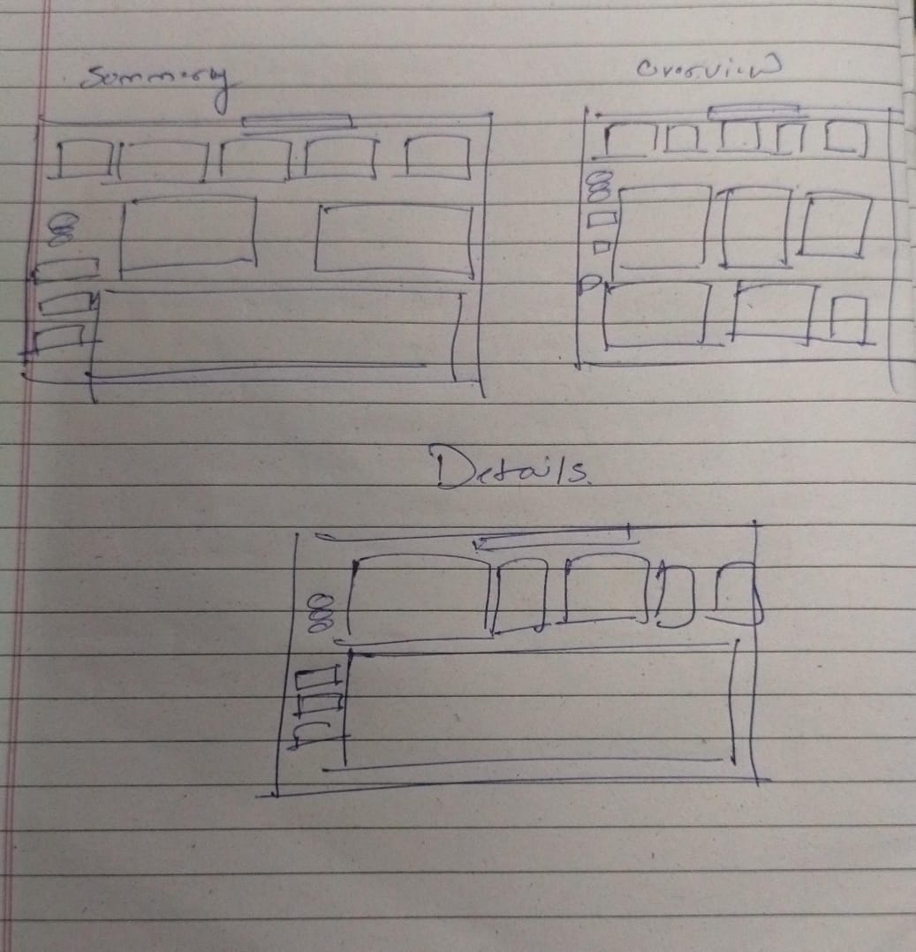
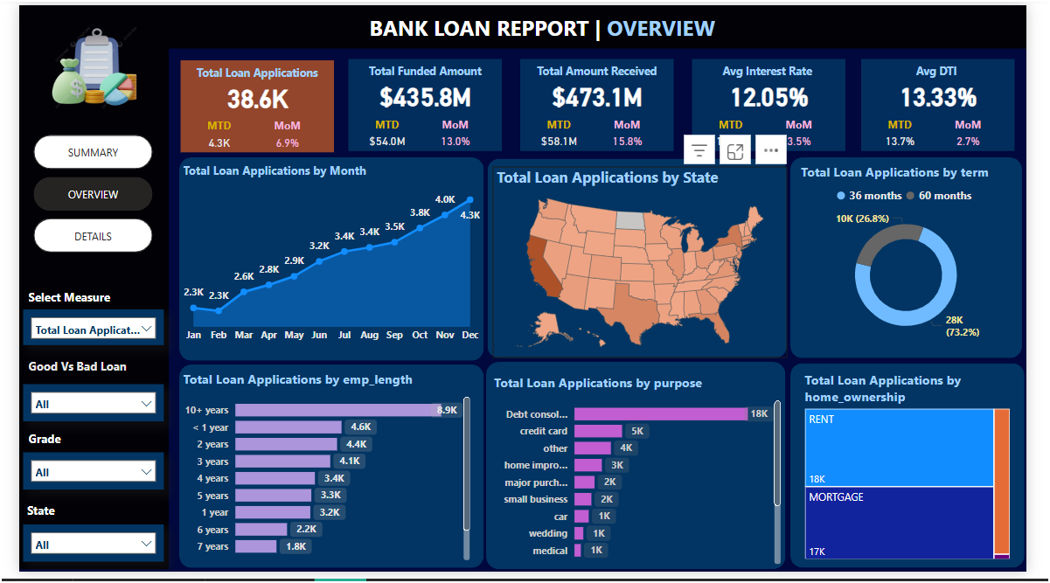
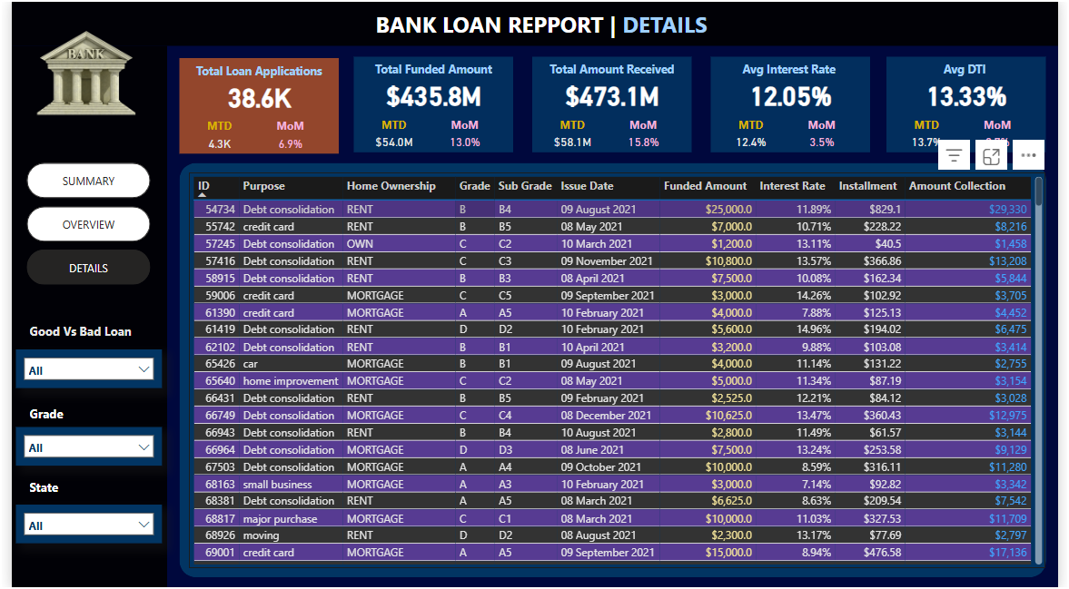
SUMMERY REPORT
"How was my approach to creating dashboards?"
Roughed Report In a Page
OVERVIEW REPORT
DETAILS REPORT

